Slide 1
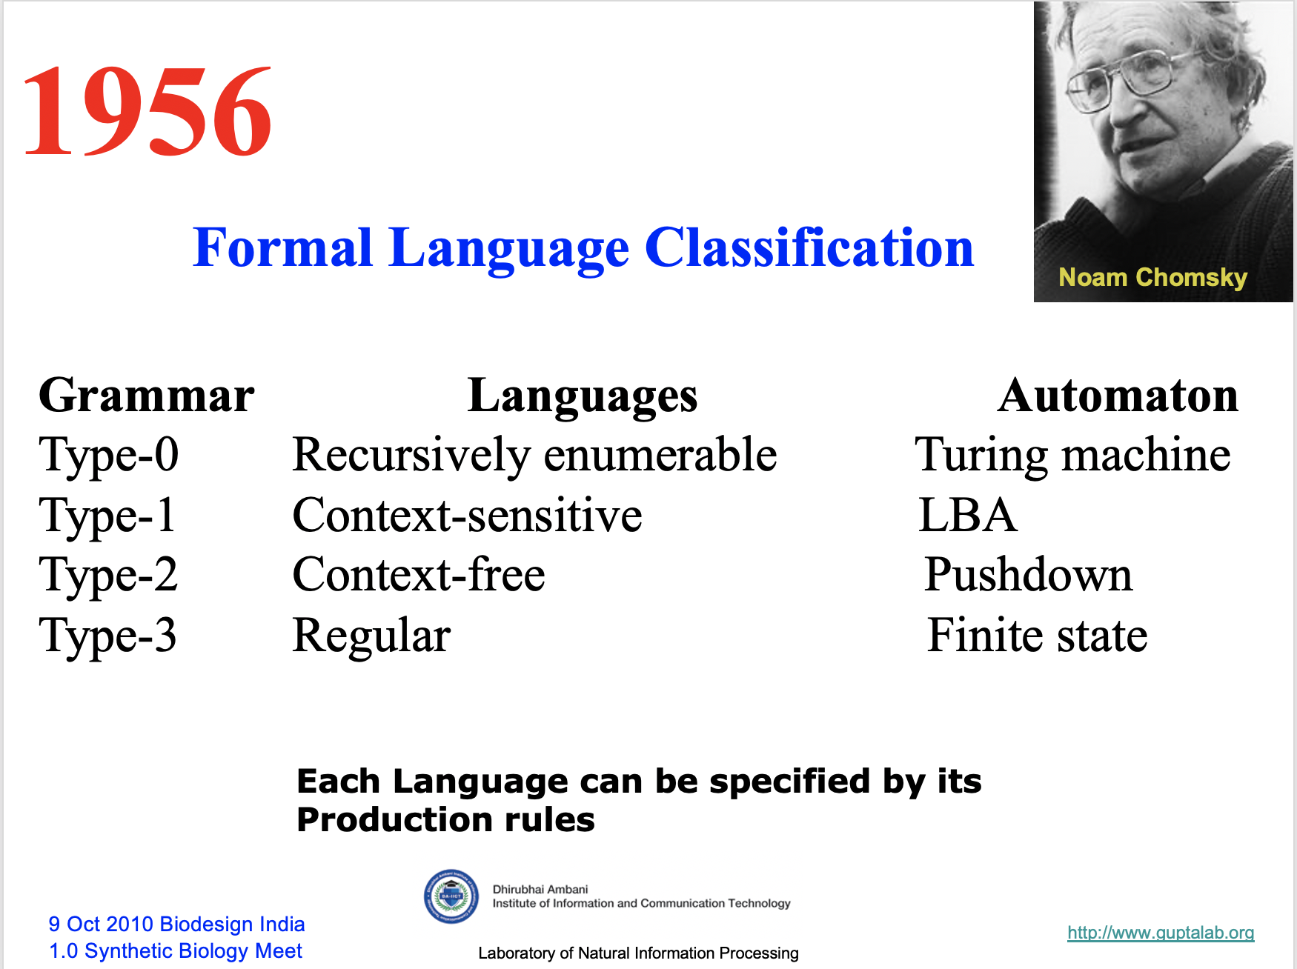

s
Prof. Busch - LSU

Slide 2

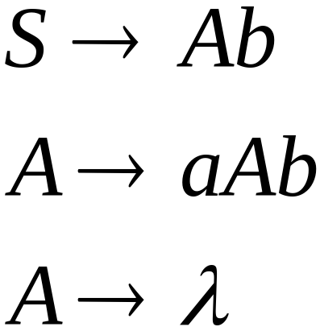
Linear Grammars
Grammars with
at most one variable at the right side
of a production
Examples:
Prof. Busch - LSU

Slide 3

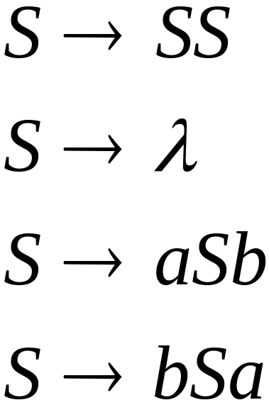
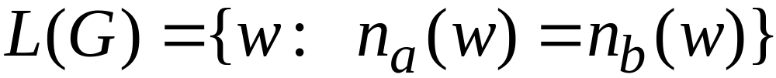


A Non-Linear Grammar
Grammar :
Number of in string
Prof. Busch - LSU

Slide 4
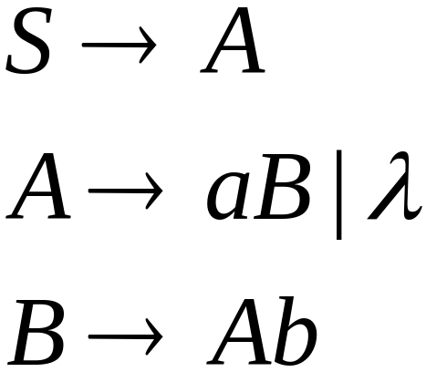
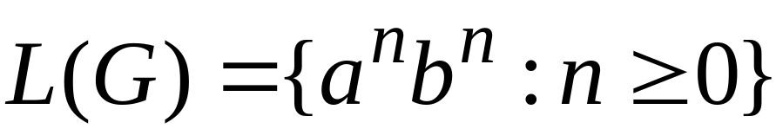
Another Linear Grammar
Grammar :
Prof. Busch - LSU

Slide 5


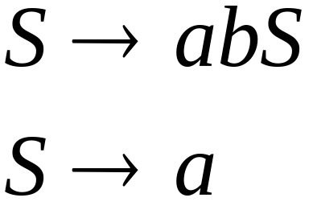
Right-Linear Grammars
All productions have form:
Example:
or
string of
terminals
Prof. Busch - LSU

Slide 6

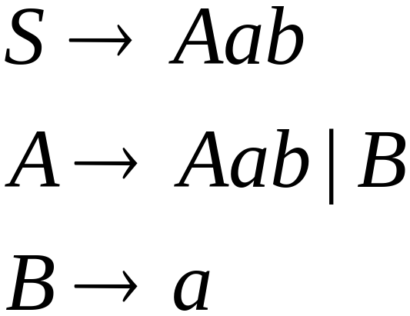
Left-Linear Grammars
All productions have form:
Example:
or
string of
terminals
Prof. Busch - LSU

Slide 7
Regular Grammars
Prof. Busch - LSU

Slide 8
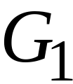
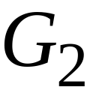
Regular Grammars
A regular grammar is any
right-linear or left-linear grammar
Examples:
Prof. Busch - LSU

Slide 9
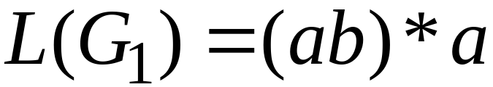
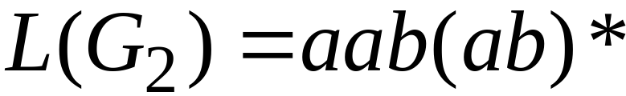
Observation
Regular grammars generate regular languages
Examples:
Prof. Busch - LSU

Slide 10
Regular Grammars
Generate
Regular Languages
Prof. Busch - LSU

Slide 11

Theorem
Languages
Generated by
Regular Grammars
Regular
Languages
Prof. Busch - LSU

Slide 12

Theorem - Part 1
Languages
Generated by
Regular Grammars
Regular
Languages
Any regular grammar generates
a regular language
Prof. Busch - LSU

Slide 13

Theorem - Part 2
Languages
Generated by
Regular Grammars
Regular
Languages
Any regular language is generated
by a regular grammar
Prof. Busch - LSU

Slide 14
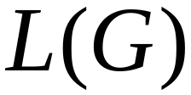
Proof – Part 1
Languages
Generated by
Regular Grammars
Regular
Languages
The language generated by
any regular grammar is regular
Prof. Busch - LSU

Slide 15

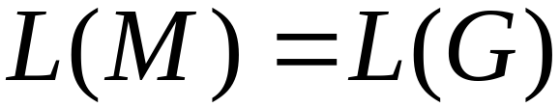
The case of Right-Linear Grammars
Let be a right-linear grammar
We will prove: is regular
Proof idea: We will construct NFA
with
Prof. Busch - LSU

Slide 16
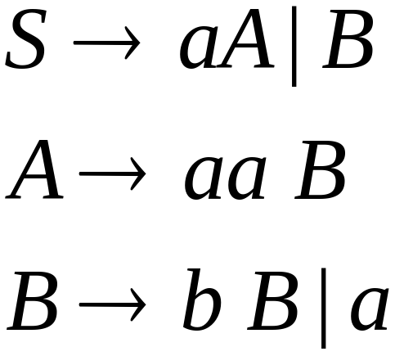
Grammar is right-linear
Example:
Prof. Busch - LSU

Slide 17



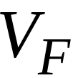

Construct NFA such that
every state is a grammar variable:
special
final state
Prof. Busch - LSU

Slide 18


Add edges for each production:
Prof. Busch - LSU

Slide 19

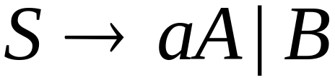
Prof. Busch - LSU

Slide 20
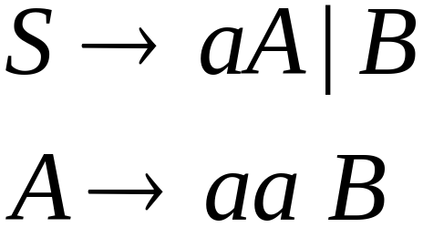
Prof. Busch - LSU

Slide 21
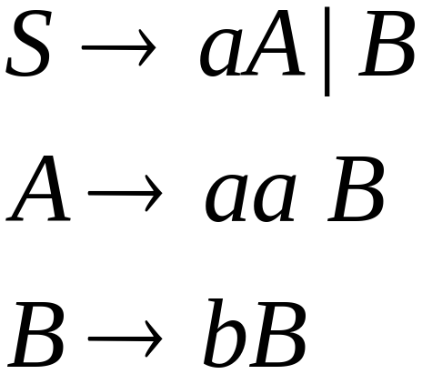

Prof. Busch - LSU

Slide 22
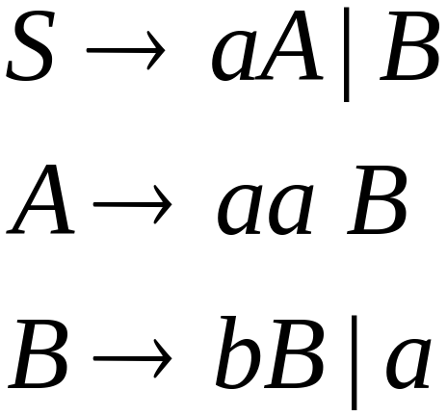
Prof. Busch - LSU

Slide 23
Prof. Busch - LSU

Slide 24
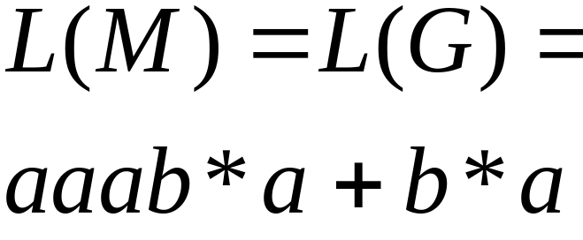
NFA
Grammar
Prof. Busch - LSU

Slide 25
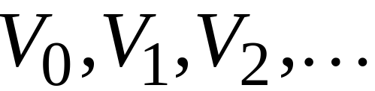
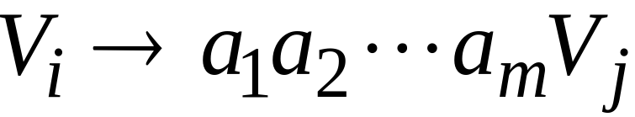
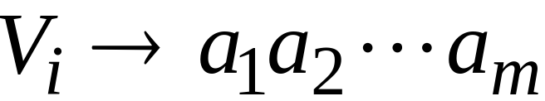
In General
A right-linear grammar
has variables:
and productions:
or
Prof. Busch - LSU

Slide 26






We construct the NFA such that:
each variable corresponds to a node:
special
final state
Prof. Busch - LSU

Slide 27


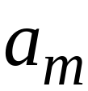


For each production:
we add transitions and intermediate nodes
………
Prof. Busch - LSU

Slide 28
For each production:
we add transitions and intermediate nodes
………
Prof. Busch - LSU

Slide 29







Resulting NFA looks like this:
It holds that:
Prof. Busch - LSU

Slide 30
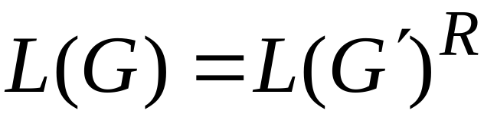

The case of Left-Linear Grammars
Let be a left-linear grammar
We will prove: is regular
Proof idea:
We will construct a right-linear
grammar with
Prof. Busch - LSU

Slide 31
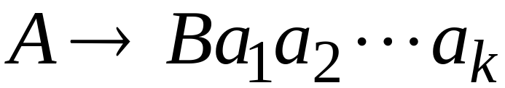
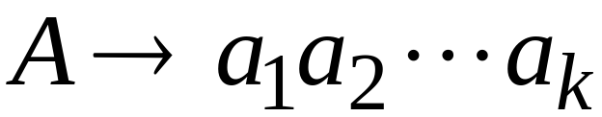
Since is left-linear grammar
the productions look like:
Prof. Busch - LSU

Slide 32

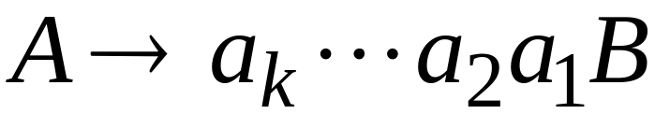
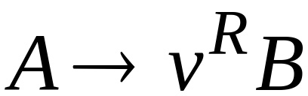
Construct right-linear grammar
Left
linear
Right
linear
Prof. Busch - LSU

Slide 33

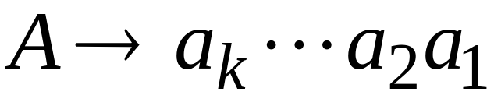
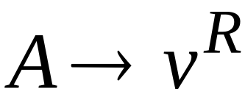
Construct right-linear grammar
Left
linear
Right
linear
Prof. Busch - LSU

Slide 34
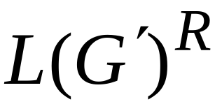
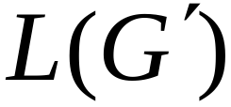
It is easy to see that:
Since is right-linear, we have:
Regular
Language
Regular
Language
Regular
Language
Prof. Busch - LSU

Slide 35

Proof - Part 2
Languages
Generated by
Regular Grammars
Regular
Languages
Any regular language is generated
by some regular grammar
Prof. Busch - LSU

Slide 36
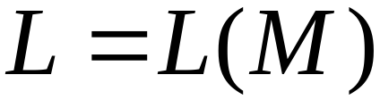
Any regular language is generated
by some regular grammar
Proof idea:
Let be the NFA with .
Construct from a regular grammar
such that
Prof. Busch - LSU

Slide 37


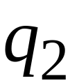
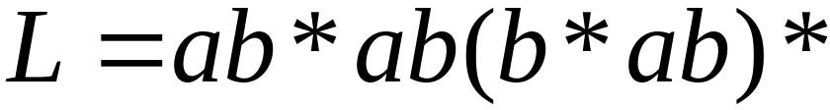

Since is regular
there is an NFA such that
Example:
Prof. Busch - LSU

Slide 38


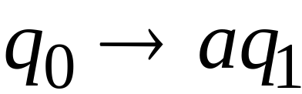

Convert to a right-linear grammar
Prof. Busch - LSU

Slide 39
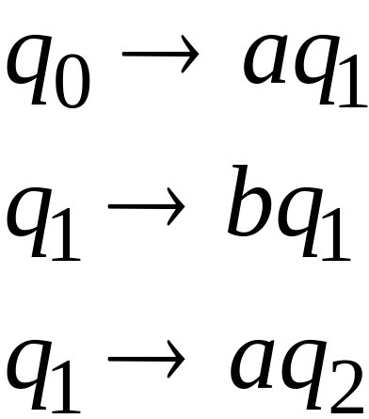
Prof. Busch - LSU

Slide 40
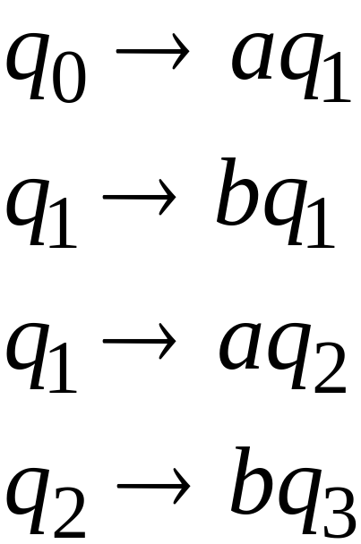
Prof. Busch - LSU

Slide 41
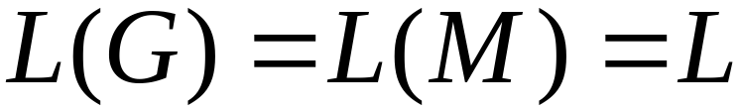
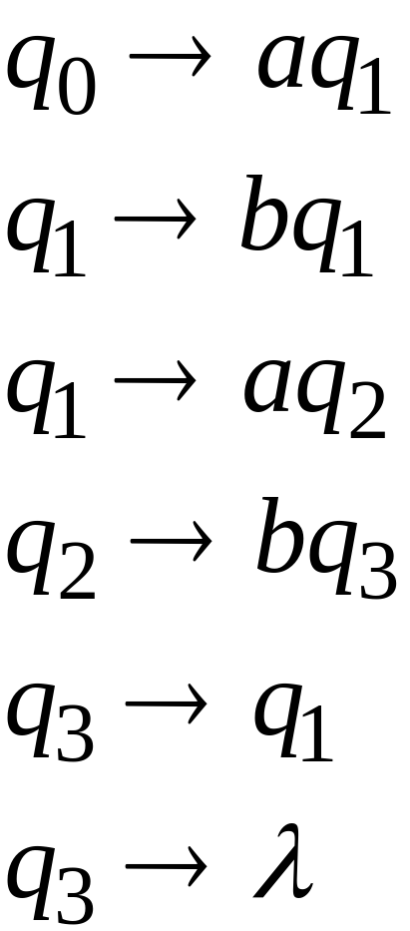
Prof. Busch - LSU

Slide 42



In General
For any transition:
Add production:
variable
terminal
variable
Prof. Busch - LSU

Slide 43

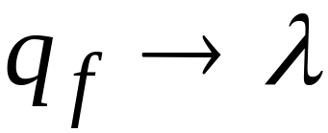
For any final state:
Add production:
Prof. Busch - LSU

Slide 44
Since is right-linear grammar
is also a regular grammar
with
Prof. Busch - LSU

